Slide 1
Software Maintenance
Software Maintenance is a very broad activity that includes
error corrections,
enhancements of capabilities,
deletion of obsolete capabilities, and optimization.

Slide 2
Software Maintenance
Categories of maintenance:
Corrective:
This refer to modifications initiated by defects(design errors, logic and coding errors) in the software.
Adaptive:
It includes modifying the software to match changes(s/w or h/w operating platforms, business, govt. rules etc.) in the ever changing environment.
Perfective:
It means improving processing efficiency or performance, or restructuring the software to improve changeability. This may include enhancement of existing system functionality, improvement in computational efficiency etc.

Slide 3
Software Maintenance
Categories of maintenance:
Other types of maintenance:
There are long term effects of corrective, adaptive and perfective changes.
This leads to increase in the complexity of the software, which reflect deteriorating structure. The work is required to be done to maintain it or to reduce it, if possible.
This work may be named as preventive maintenance.

Slide 4
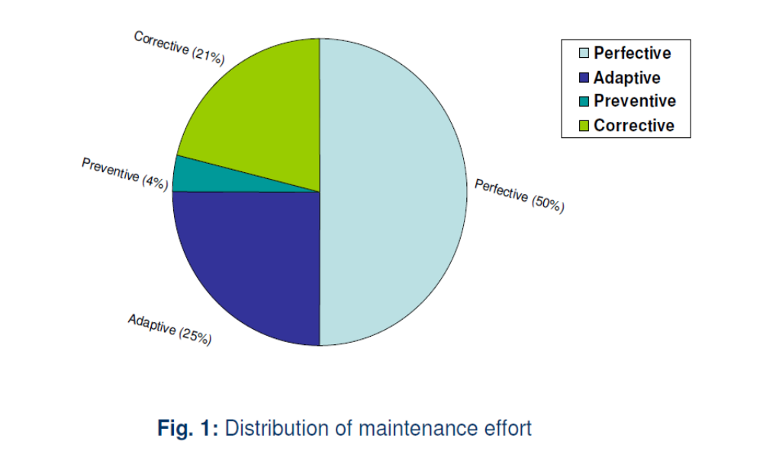
Software Maintenance

Slide 5
Software Maintenance
Problems during maintenance:
Often the program is written by another person or group of persons.
Often the program is changed by person who did not understand it clearly.
Program listings are not structured.
High staff turnover.
Information gap.
Systems are not designed for change.

Slide 6
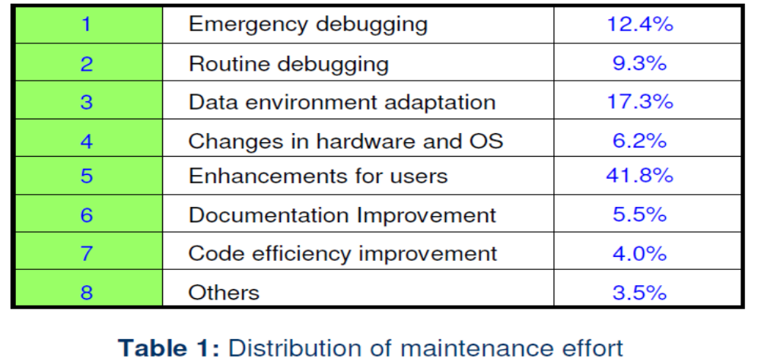
Software Maintenance
Maintenance is manageable:
A common misconception about maintenance is that it is not manageable.
Report of survey conducted by Lientz & Swanson gives some interesting observations:

Slide 7
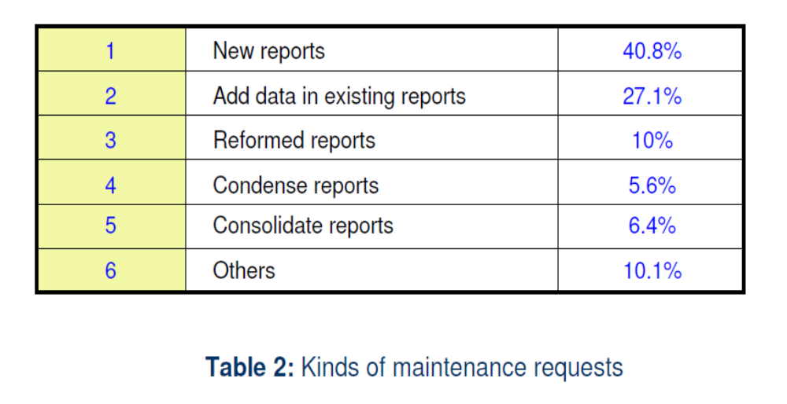
Software Maintenance
Kinds of maintenance request:

Slide 8
Software Maintenance
Potential solutions to maintenance problems :
Budget and effort reallocation
Complete replacement of the system
Maintenance of existing system

Slide 9
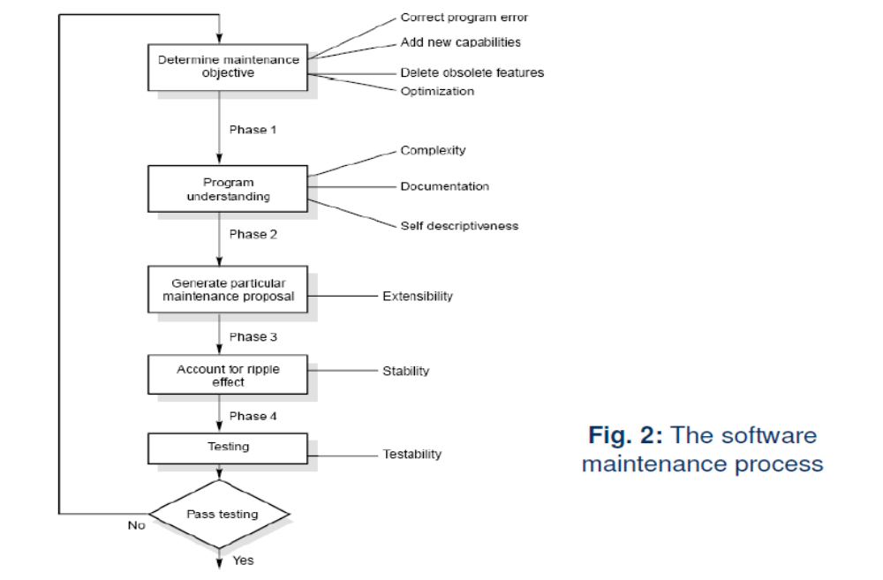
Software Maintenance
The maintenance process :

Slide 10
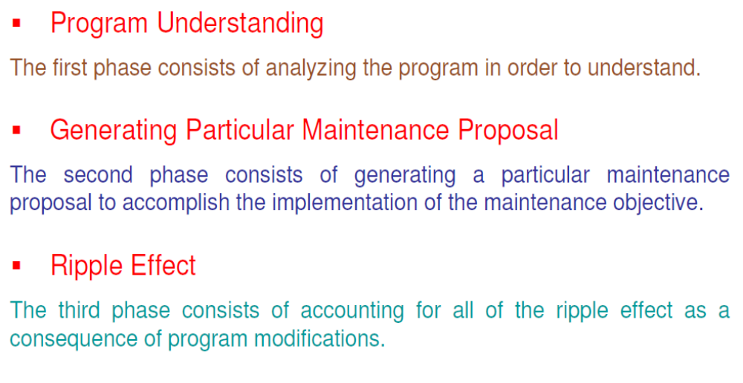
Software Maintenance
The maintenance process :

Slide 11
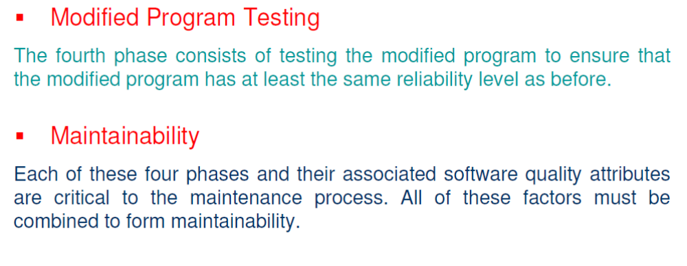
Software Maintenance
The maintenance process :

Slide 12
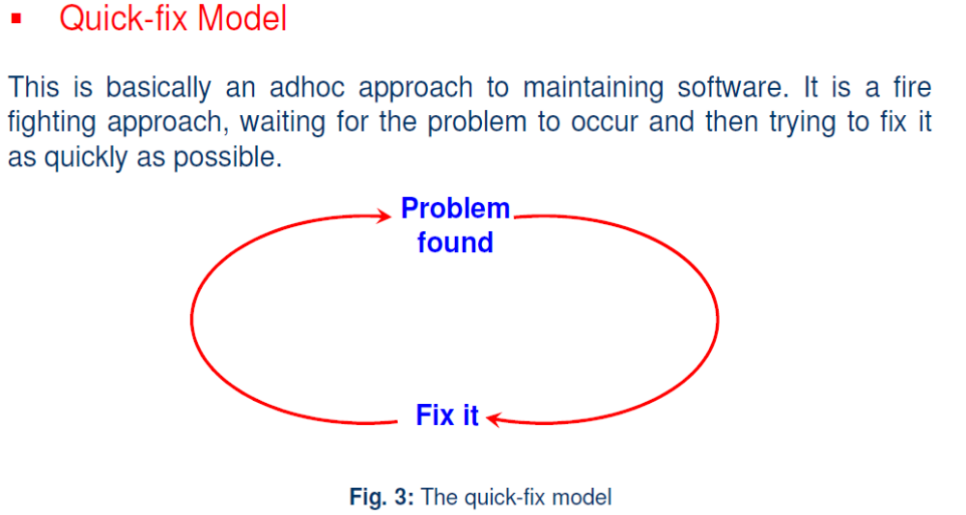
Software Maintenance
Maintenance models :

Slide 13
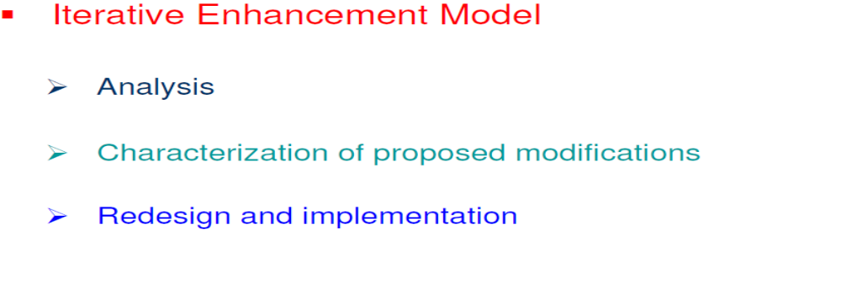
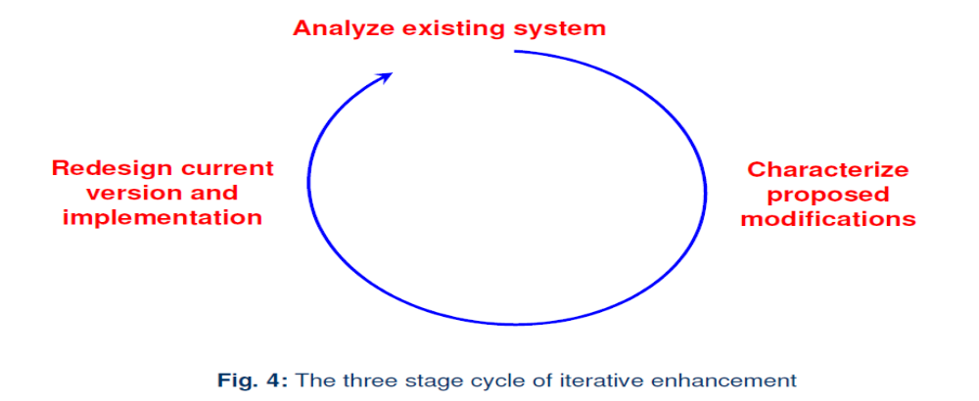
Software Maintenance
Maintenance models :

Slide 14
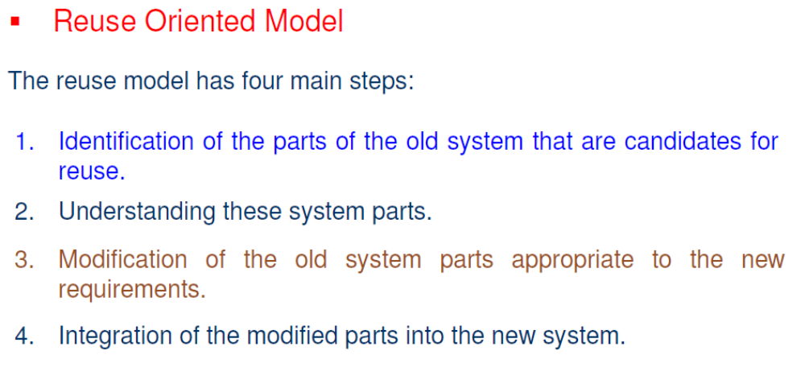
Software Maintenance
Maintenance models :

Slide 15
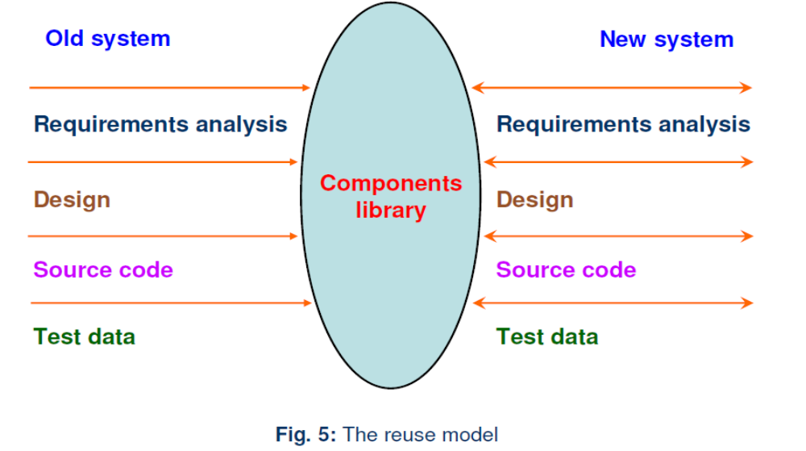
Software Maintenance
Maintenance models :

Slide 16
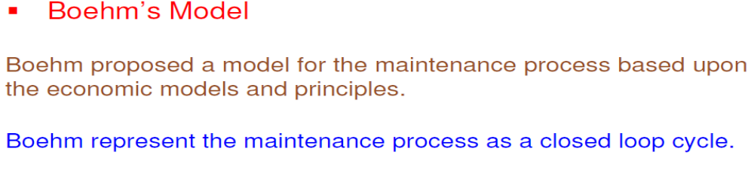
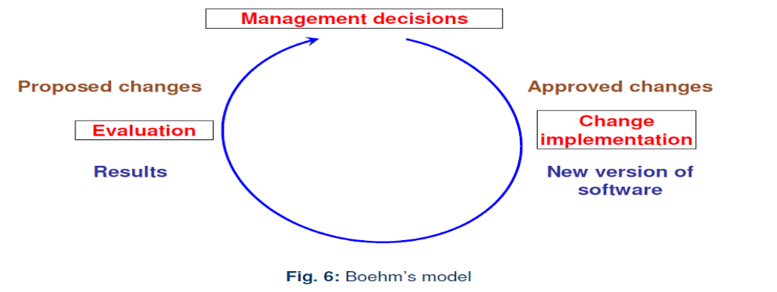
Software Maintenance
Maintenance models :

Slide 17
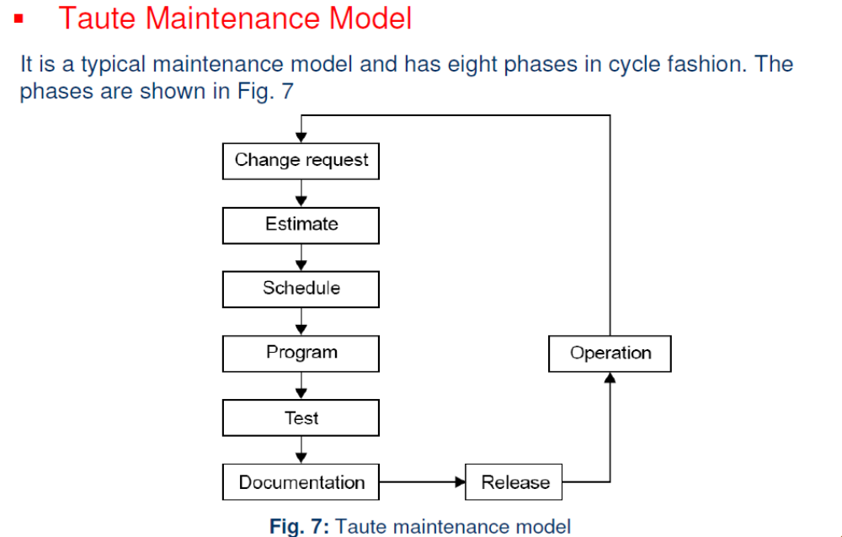
Software Maintenance
Maintenance models :

